Slide 1
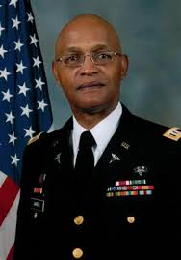
Junior-ROTC
Presented to you by the Richland High Battalion
And our Captain, Warren Harris

Slide 2
Our Mission
Our mission in JROTC is to “motivate young people to become better citizens”.
Upon graduation from High School, students will be equipped with Life and Leadership Skills to prepare them for the future.

Slide 3
Our Program
“JROTC DOES NOT RECRUIT YOU, OR MAKE YOU GO TO THE MILITARY!! It is for students who wish to serve their school and community, For some students JROTC is a a place for people to belong and get along. For others, this program is for future leaders of corporations, organizations, presidents, senators, and or military officers. If you join this program, and you put your all into your school and JROTC, you will not only be successful, but also a phenomenal Leader. I guarantee you that JROTC is not just for people who want to go into the military, it’s for people who want to be leaders.”
Cadet MAJ Hallie Reno, RHSJROTC Executive Officer (XO)

Slide 4
In School Activities-
Our in school activities include the following:
Raiders
PT(Physical Training)
Drill
Color Guard
Academics
Leadership
Team Building

Slide 5
Classroom subjects-
Our classroom subjects include the following:
Drill and Ceremonies
American History
School Service
Career Planning
Academics
Leadership
Team Building

Slide 6
Classroom subjects-
Our classroom subjects include the following:
Financial Planning
Military History
Personal Skills
ACT and SAT Preparation
Community Service
Full ride scholarships
JROTC and Military benefits

Slide 7
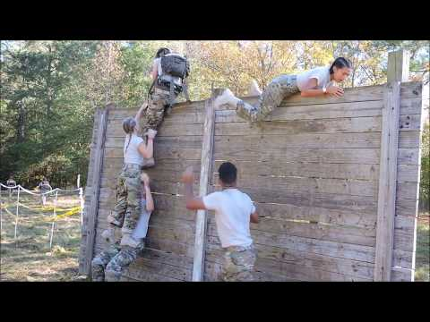
Raiders-
This is a video of a Raiders Competition in 2019
“This is what we would like to accomplish by next year.”
From: Cadet MAJOR (C/MAJ) Hallie Reno, RHSJROTC Executive Officer (XO)

Slide 8
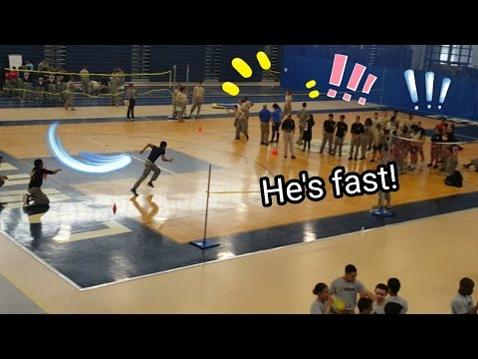
PT(Physical Training)-
“This is a video of a PT competition, but may vary depending on the location of the competition.”
From: Cadet First Sergeant (C/1SG) Vincent Brown, PT Captain

Slide 9
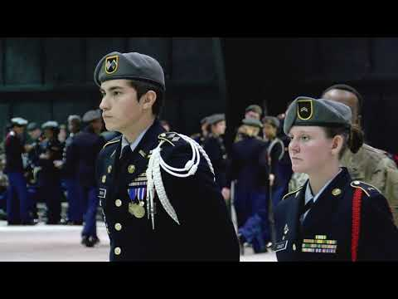
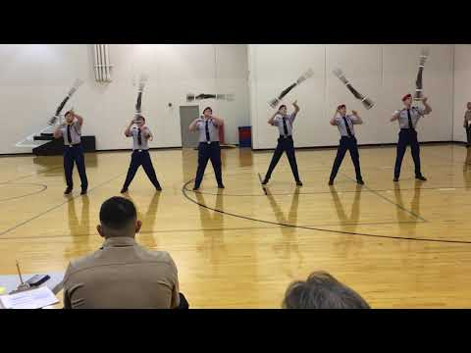
Drill
This is a video of how drill and drill competitions are conducted.
“My goal is to have us be able to perform Drill like this.”
Hallie Reno, XO
Hallie Reno

Slide 10
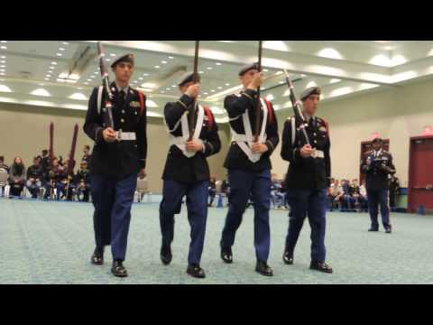
Color Guard
“Color Guard performs the flag ceremonies at special events such as award ceremonies, football games, community events, school events, and places where we pay honors to our country”.
Justin Shelly, Cadet Lieutenant Colonel, (C/LTC) Battalion Commander

Slide 11
Academics/Leadership
“The JROTC Academic team mainly studies subjects such as Math, English, Science, Military History and JROTC history. The cadets in the academic team participate in an Academic Bowl each year there are 2 preliminary rounds, and if your team passes these rounds they can compete against nationally recognized schools in Washington D.C.”
“The Leadership team studies leadership attributes and situations to try and become a better leader and a better citizen. Like the Academic Bowl the Leadership Bowl has 2 preliminary rounds, and if your team manages to pass these rounds they have a chance to compete in Washington D.C.”
LAUREN JONES, Cadet Major (C/MAJ). Battalion Training Officer (S-3)
Notes:
Is this better?- haney

Slide 12
Team Building
Team Building in JROTC is important because it gives the cadets a chance to work together to accomplish a goal. Whether be it a academically involved on or physical, we still work together as a team.

Slide 13
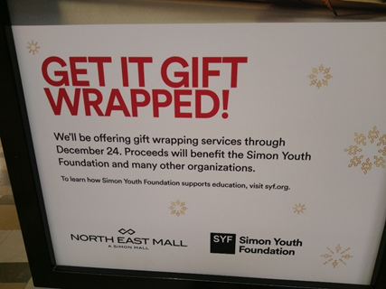
Community Service
American Heart Association Heart Walk with RHS JROTC
“JROTC has participated in the American Heart Association annual HEART WALK’ and held gift wrapping fundraisers at NorthEast Mall to benefit the Simon Youth Foundation”
From: STEPHEN HANEY, Cadet Captain(C/CPT), Special Projects Officer (S-6)
Notes:
Is this good- haney

Slide 14
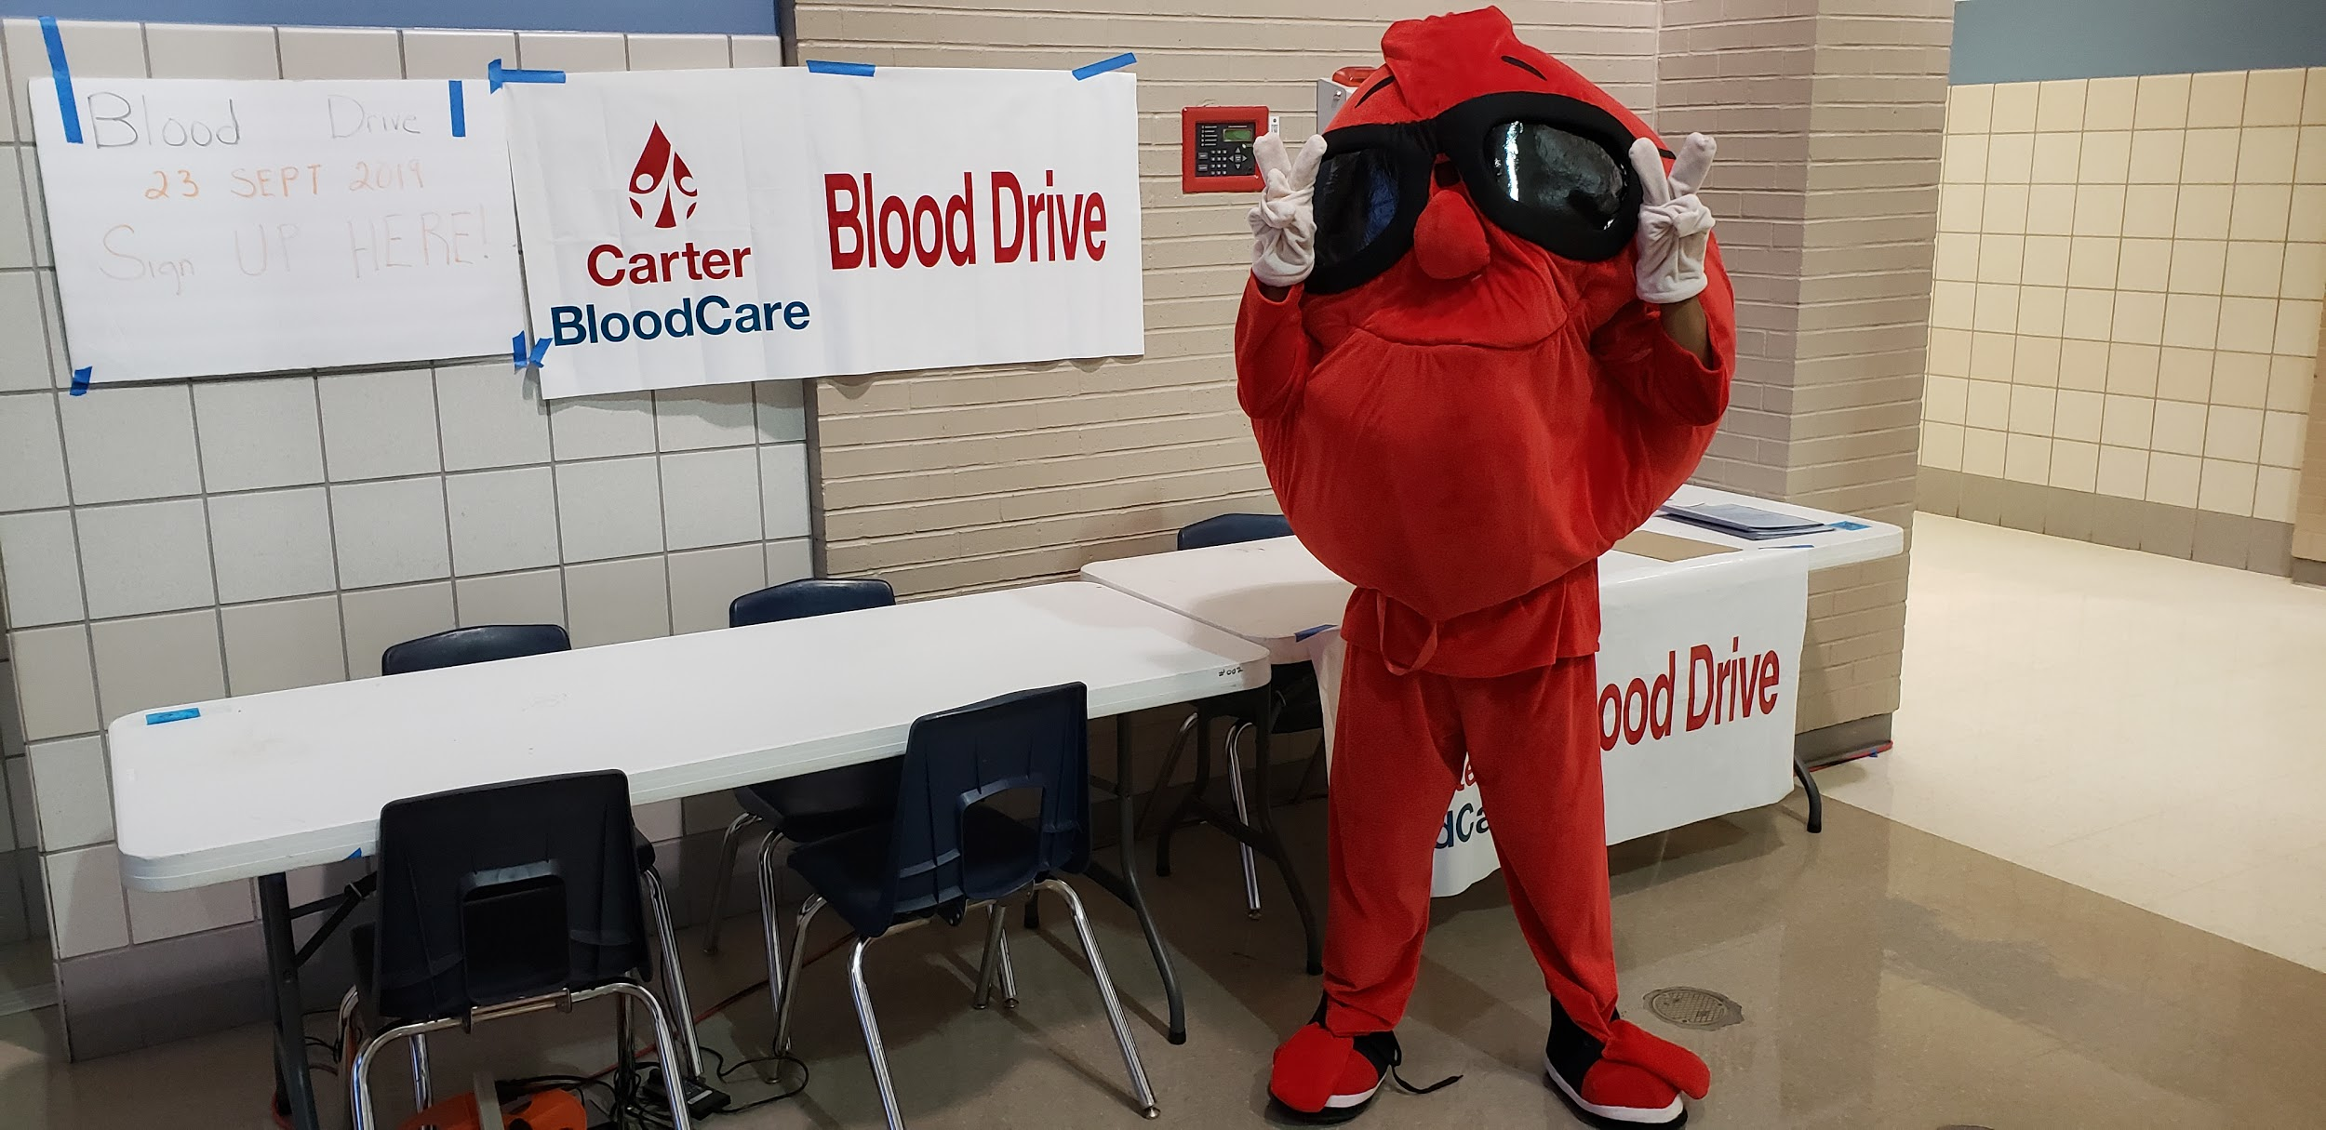
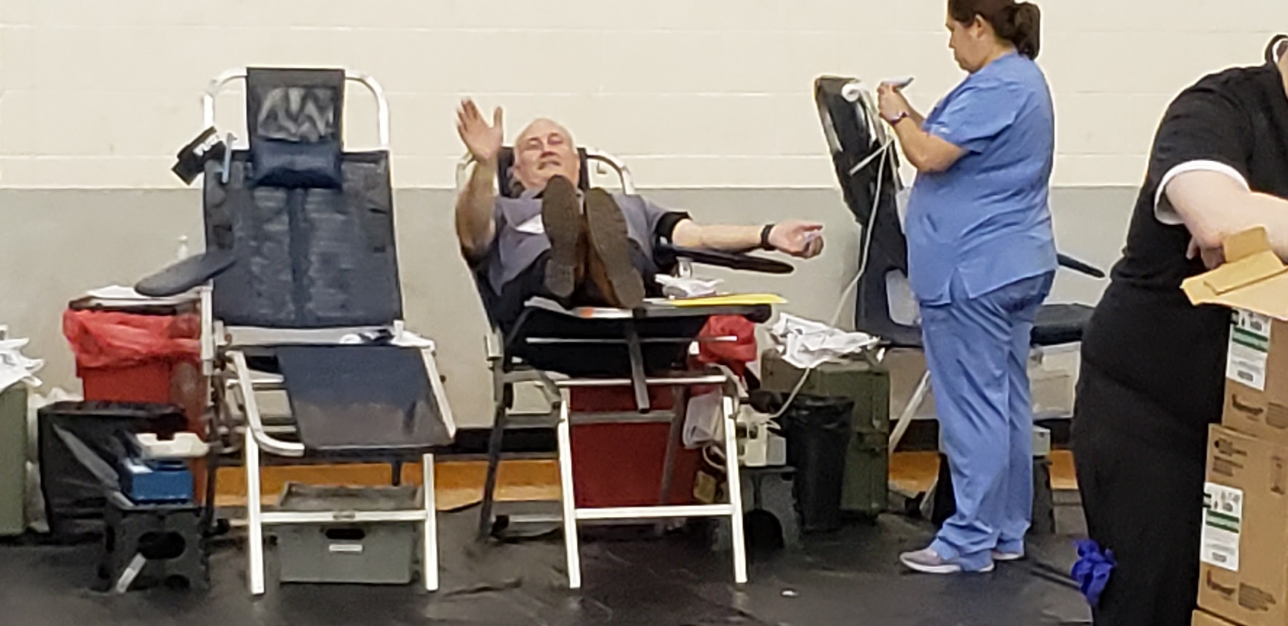
Community Service
RHS JROTC BLOOD DRIVE
“JROTC encourages cadets to participate
in community service projects, this helps
better our community and make us better
Leaders. In previous years we have done blood drives with Carter Blood Care”
From: STEPHEN HANEY, Cadet Captain(C/CPT), Special Projects Officer (S-6)
Notes:
Is this good- haney

Slide 15
“JROTC encourages students to take care of themselves and participate in their school and community. JROTC gives the student life skills which they will use now and in the future.
Do yourself , your ,school and your community a sevice: JOIN RHS JROTC!!!
From the RHSJROTC Staff:
Battalion Commander /LTC JUSTIN SHELLY Battalion Executive Officer C/MAJ HALLIE RENO
Battalion Sergeant Major C/CSM DARREN ARCE Battalion S-1 Adjutant C/CPT TAYLOR McCURDY
Battalion S-2 Intelligence and Public Affairs C/CPT JOHN HERNANDEZ
Battalion S-3 Training and Operations Officer C/MAJ LAUREN JONES
Battalion S-4 Supply Officer C/CPT ERIN POWELL
Battalion S-5 Public Affairs/Communications C/CPT JONAH JAMIESON
Battalion S-6 Special Projects Officer C/ CPT STEPHEN HANEY
From: STEPHEN HANEY, Cadet Captain(C/CPT), Special Projects Officer (S-6)
Notes:
Is this good- haney

